Slide 1
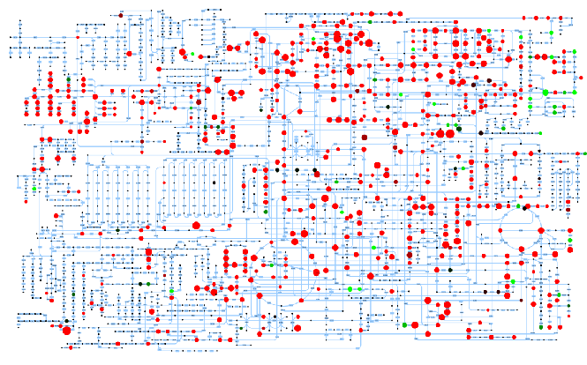
METABOLOMIC ANALYSIS OF MELANOMA CELLS
Analyses performed on SK-Mel31 VEGFR2 WT, VEGFR2 R1032Q, VEGFR2 WT SLC1A5 SH, VEGFR2 R1032Q SLC1A5 SH cells

Slide 2
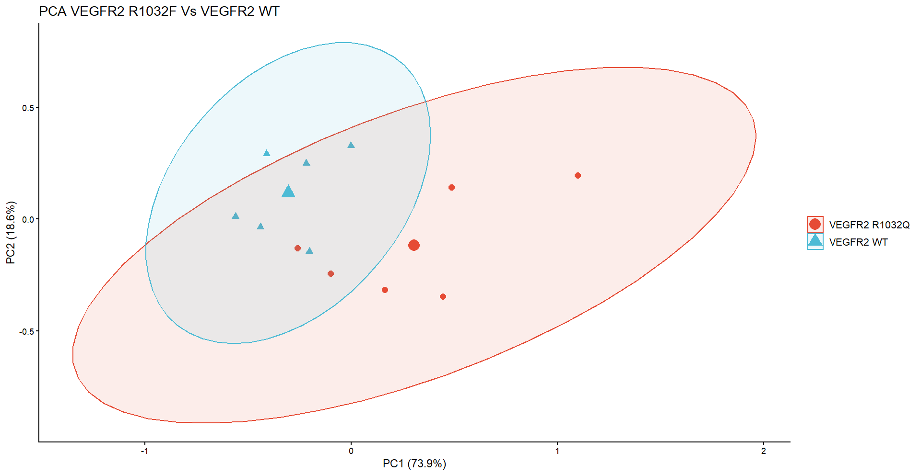
1. PCA, VOLCANO PLOT, & PATHWAY ENRICHMENT ANALYSES of WT vs R1032Q
PCA has been performed in R software ( R version 4.6.0) using the following libraries: corrr, ggcorrplot, Factominer, factoextra, readxl, ggplot2, tidyverse, ggrepel, dplyr
The code will be uploaded into github and rendered public.
The following is the PCA obtained for VEGFR2 WT and VEGFR2 R1032Q

Slide 3
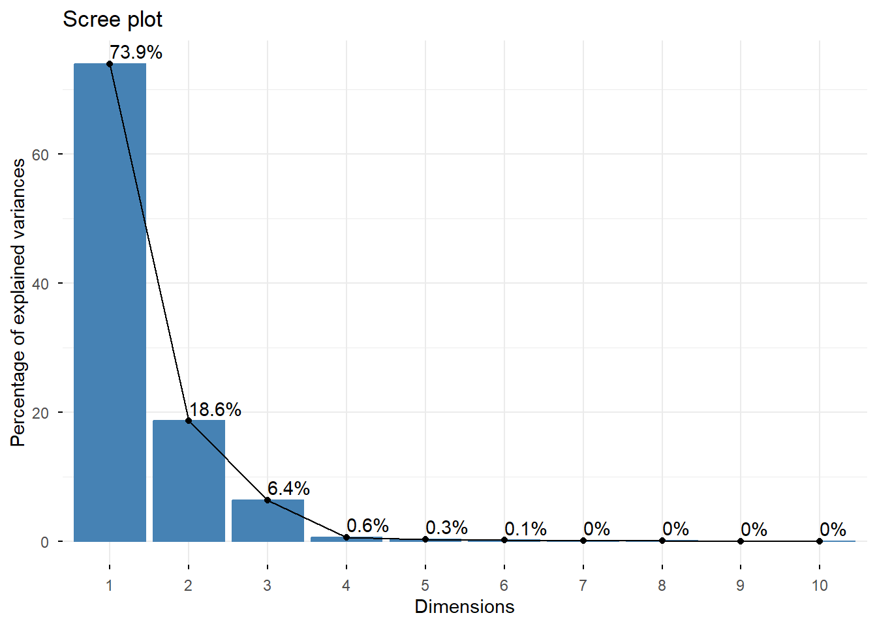
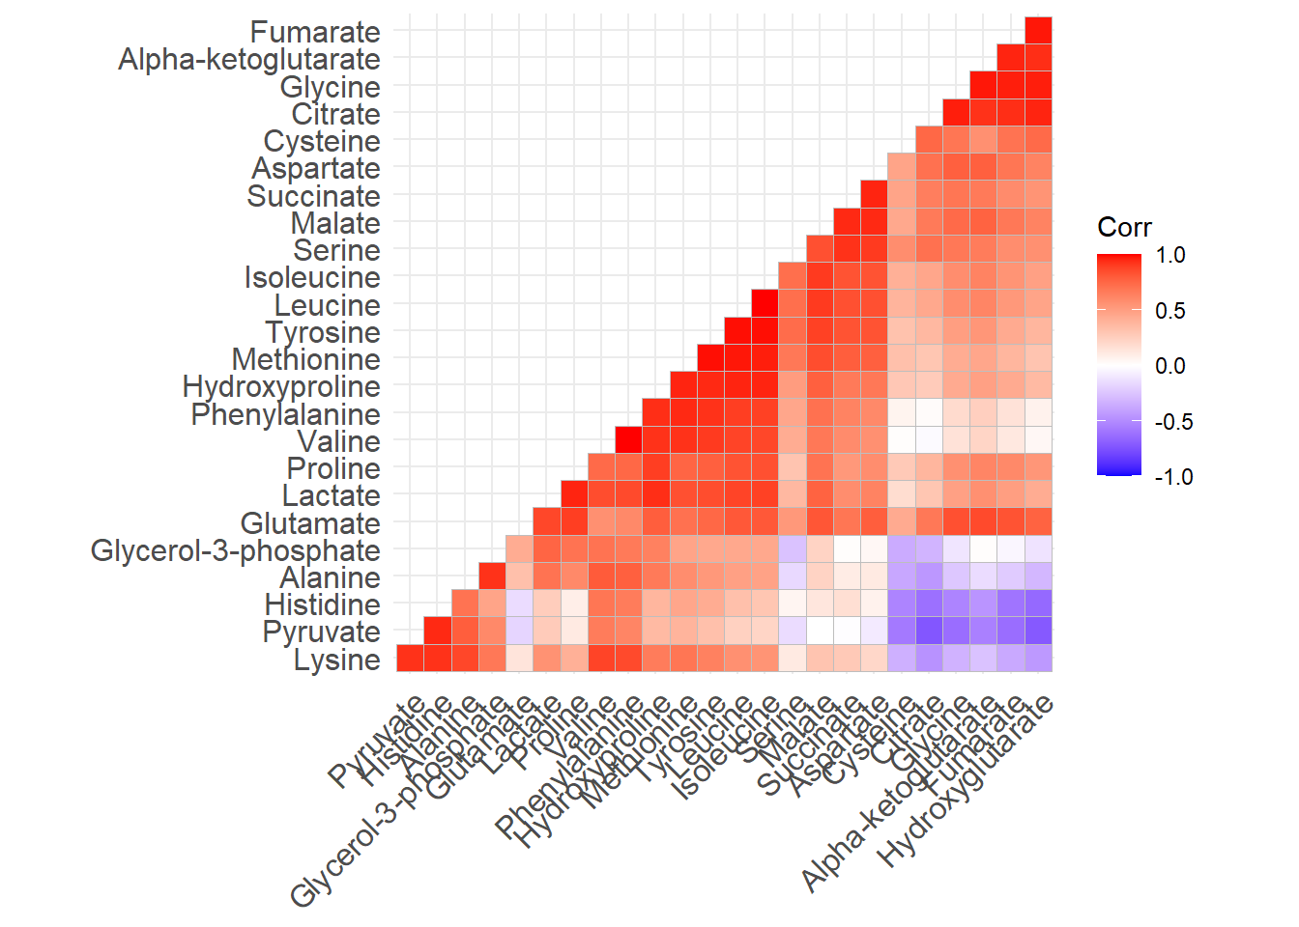
Data have been clustered along PC1 and PC2, being the components responsible for the majority of the variance of the studied dataset, as demonstrated in the following graph, shown along side the correlation matrix
Principal component analysis has produced two quasi distinct clusters, as a certain degree of overlap is observed. Nonetheless, one can infer that there are indeed two cellular populations of Sk-mel31. However, there is a considerable intra-cluster variance due to batch dependent and random variations.

Slide 4
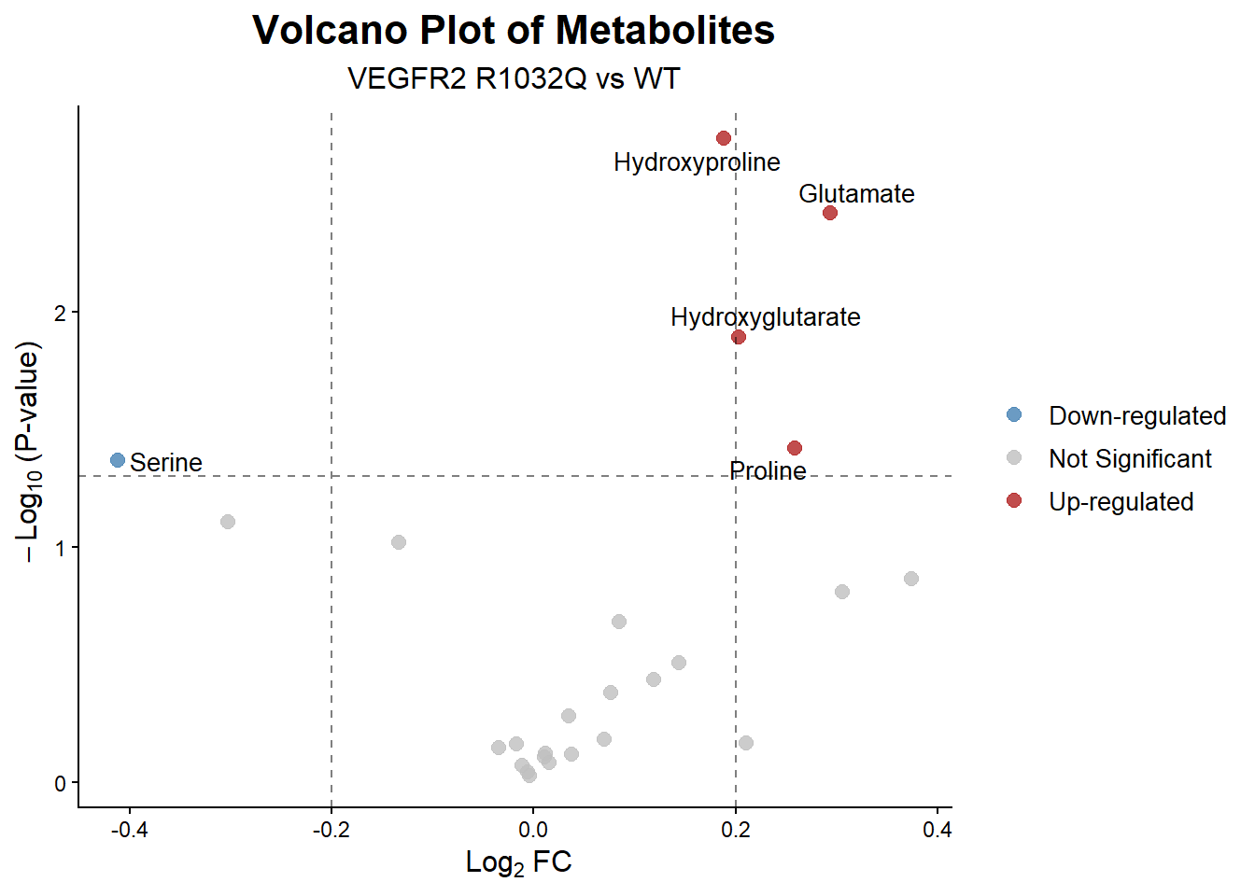
The subsequent volcano plot highlights the significant fold changes of metabolites. The p-value has been calculated using Welch T-testing method, assuming unequal variances. No correction has been applied as the sample sizes used for student testing made the implementation of BH(FDR calculation) correction unnecessary. P-value of 0.05 and Log2 FC of 0.2 were used as cut-off values. Fold changes were calculated by comparing VEGFR2 R1032Q against VEGFR2 WT.

Slide 5
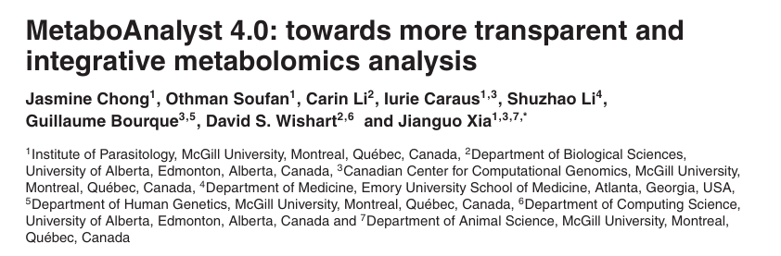
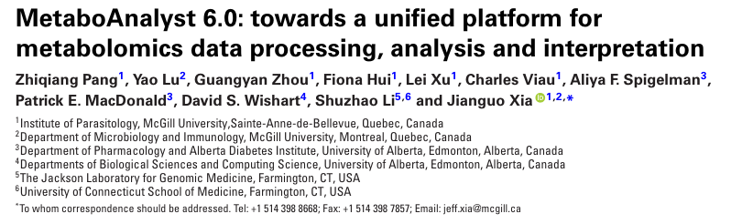
Metabolites such as Glutamate, Hydroxyproline, Hydroxyglutarate, and Proline are increased. This implies an upregulation of the Glutaminolytic pathway, and of the synthesis of collagen precursors. Moreover an increase of TCA cycle kinetics is indirectly corroborated by the accumulation of Hydroxyglutarate.
On the other hand, a reduction in Serine concentration implies that its precursor, 3-phosphoglycerate, is funnelled through the glycolytic pathway.
These considerations are corroborated by pathway enrichment analyses shown in the following pages. The idea is to perform a metabolic equivalent of GSEA so as to identify those metabolic pathways in which the most significant metabolites, i.e. those whose concentration variation are statistically significant, act as metabolic intermediates.
The analysis has been performed by downloading the R package of the MetaboAnalyst Software. The script for its installation in the R 4.3.2 version has been rendered available. The installation script has yet to be tested on the R 4.6.0 version.

Slide 6
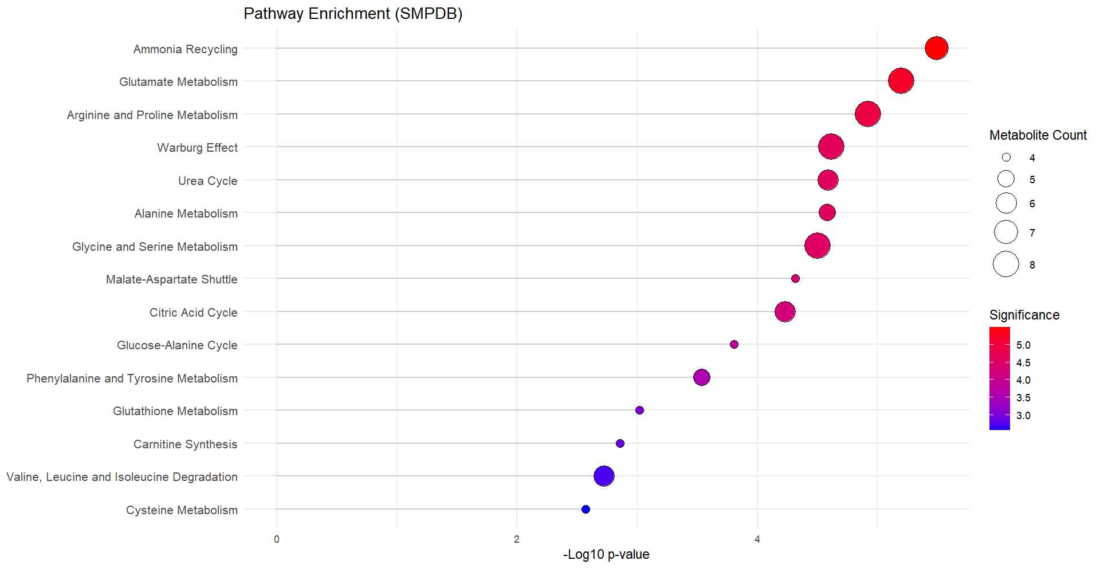
Three enrichment analyses have been performed. The first analysis is the ORA, a.k.a Over Representation analysis, for the selection of the most present pathways. The second analysis allows the specific identification of the involved pathways using Kegg pathway repositories as to evaluate the significant impacts of the indentified pathways. The third analys is the quantitative enrichment analysis which evaluates the identified pathways by FDR and statistical significance.
The code for the execution of this pathways will be rendered public (Github maybe?).
The following is the result of the ORA analys using smpdb database

Slide 7
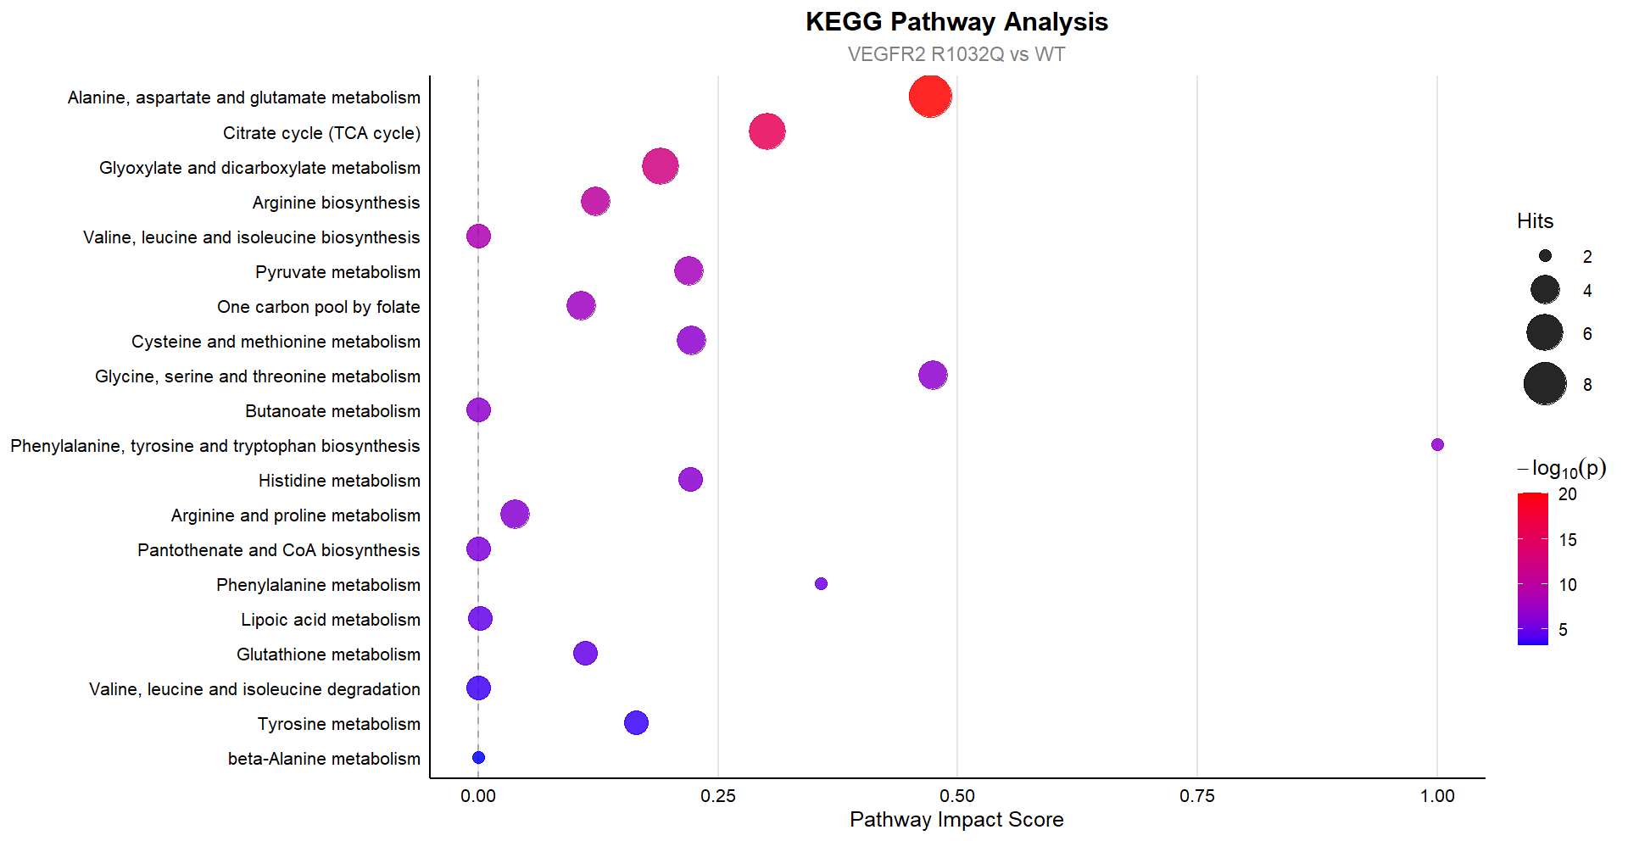
The most involved pathways are those concering the TCA cycle, amino acid metabolism, and the warburg effect. These results corroborate the considerations inferred from the volcano plot.
The following is the result of the Kegg enrichment analysis

Slide 8
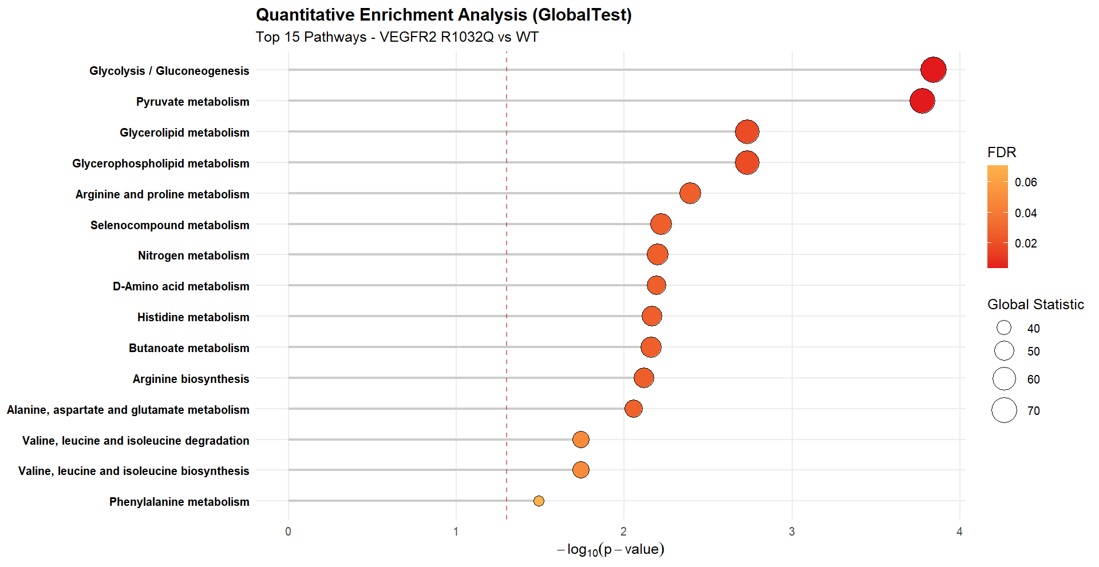
The most impactful pathways are the TCA cycle, the metabolism of Alanine, Aspartate and Glutamate and the metabolism of Glycine, Serine and Threonine.
The following is the result of the QEA analysis, which further corroborates the results of ORA and KEGG enrichment

Slide 9
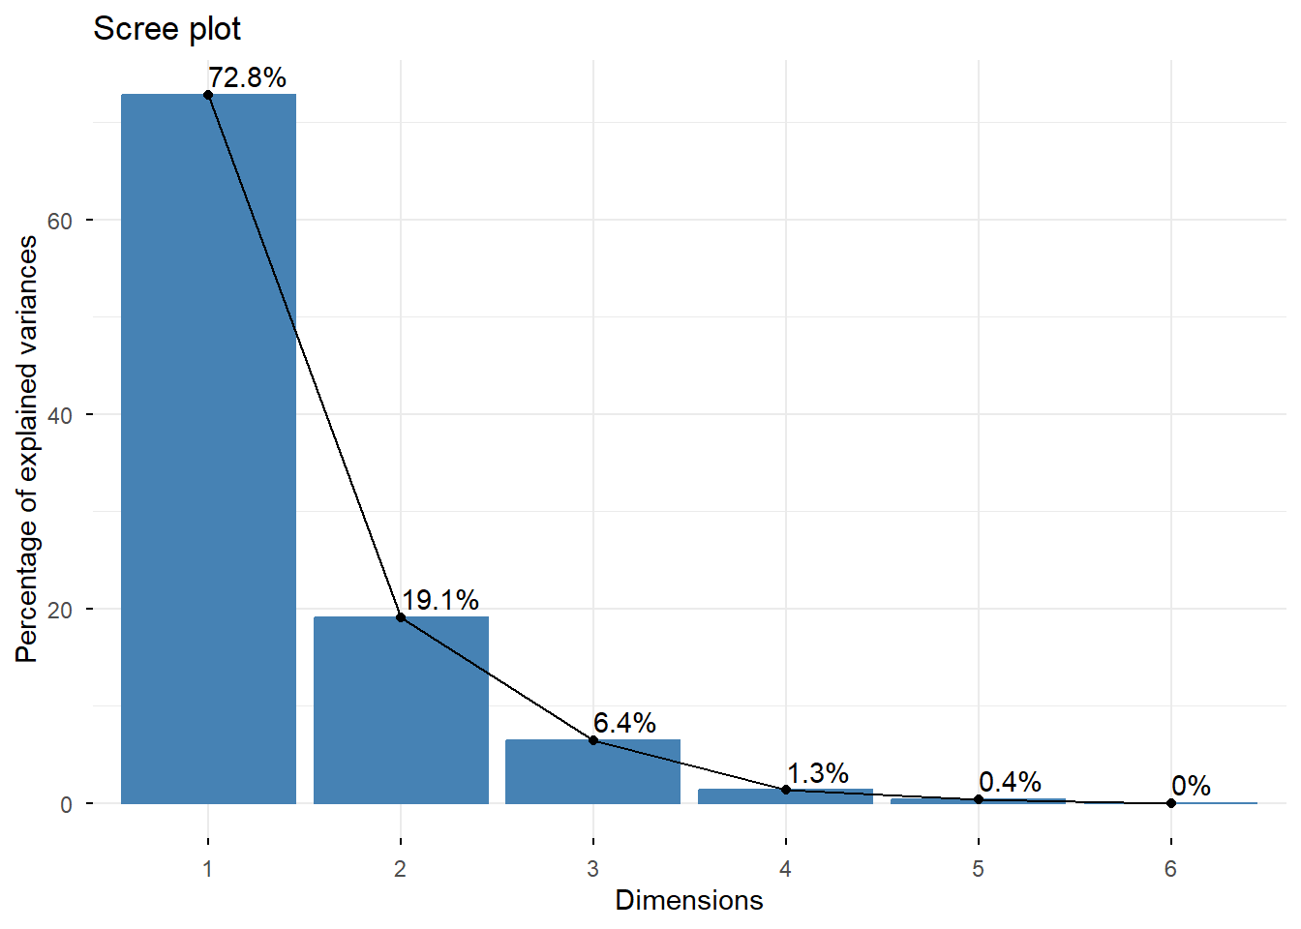
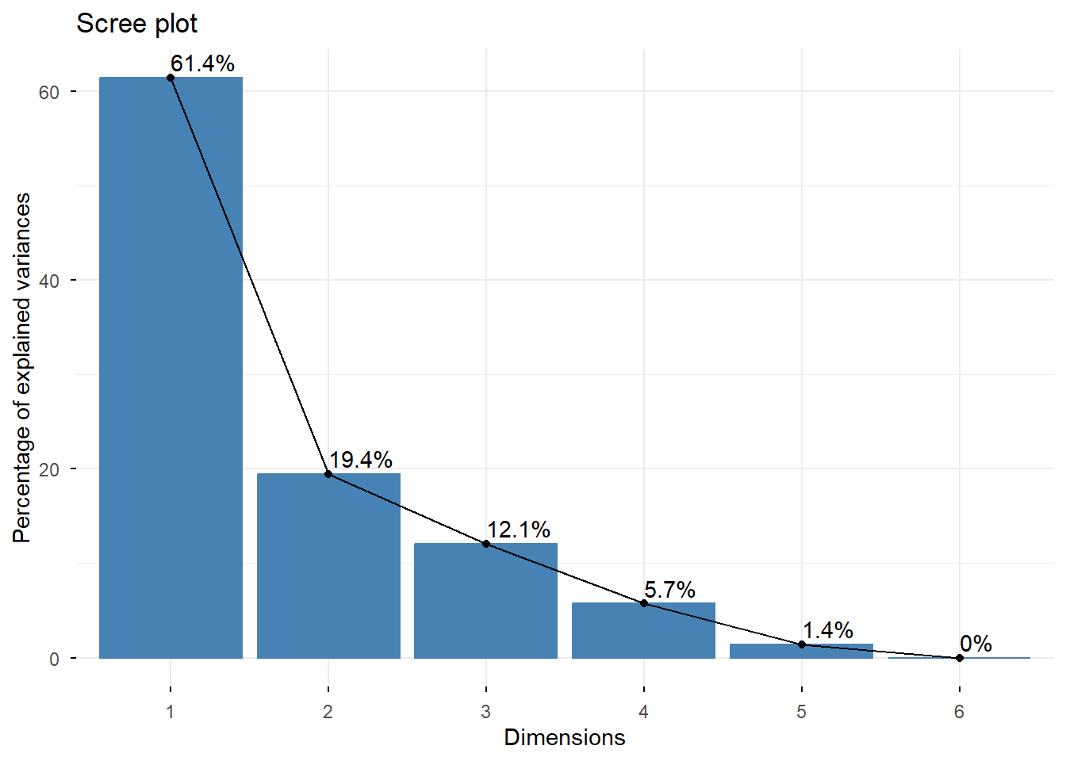
2. PCA & VOLCANO PLOT FOR SH SLC1A5
We compared VEGFR2 R1032Q SH SLC1A5 against VEGFR2 R1032Q, as well as VEGFR2 WT SH SLC1A5 against VEGFR2 WT. The following are the results of the PCA analyses.
In this case data have been clustered along three principal components.
VEGFR2 R1032Q SH SLC1A5 vs VEGFR2 R1032Q
VEGFR2 WT SH SLC1A5 vs WT

Slide 10
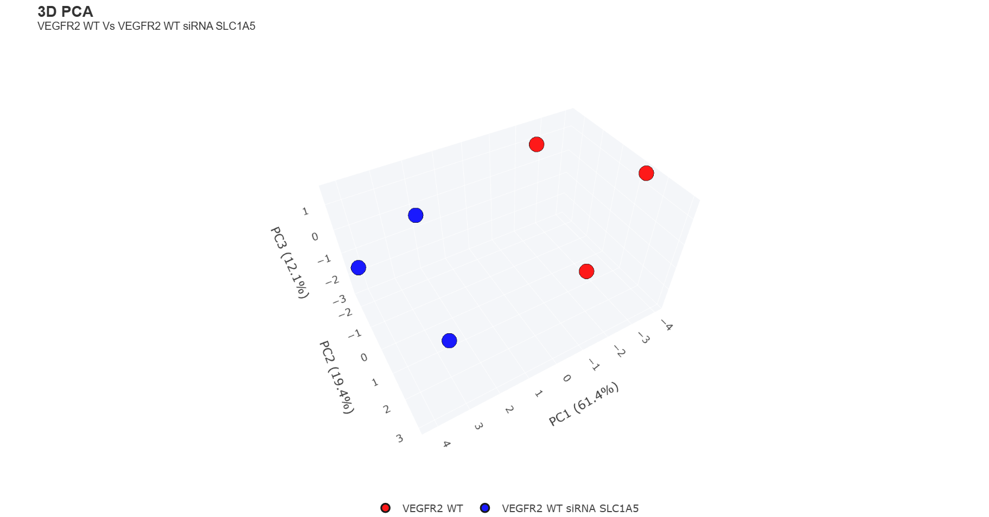
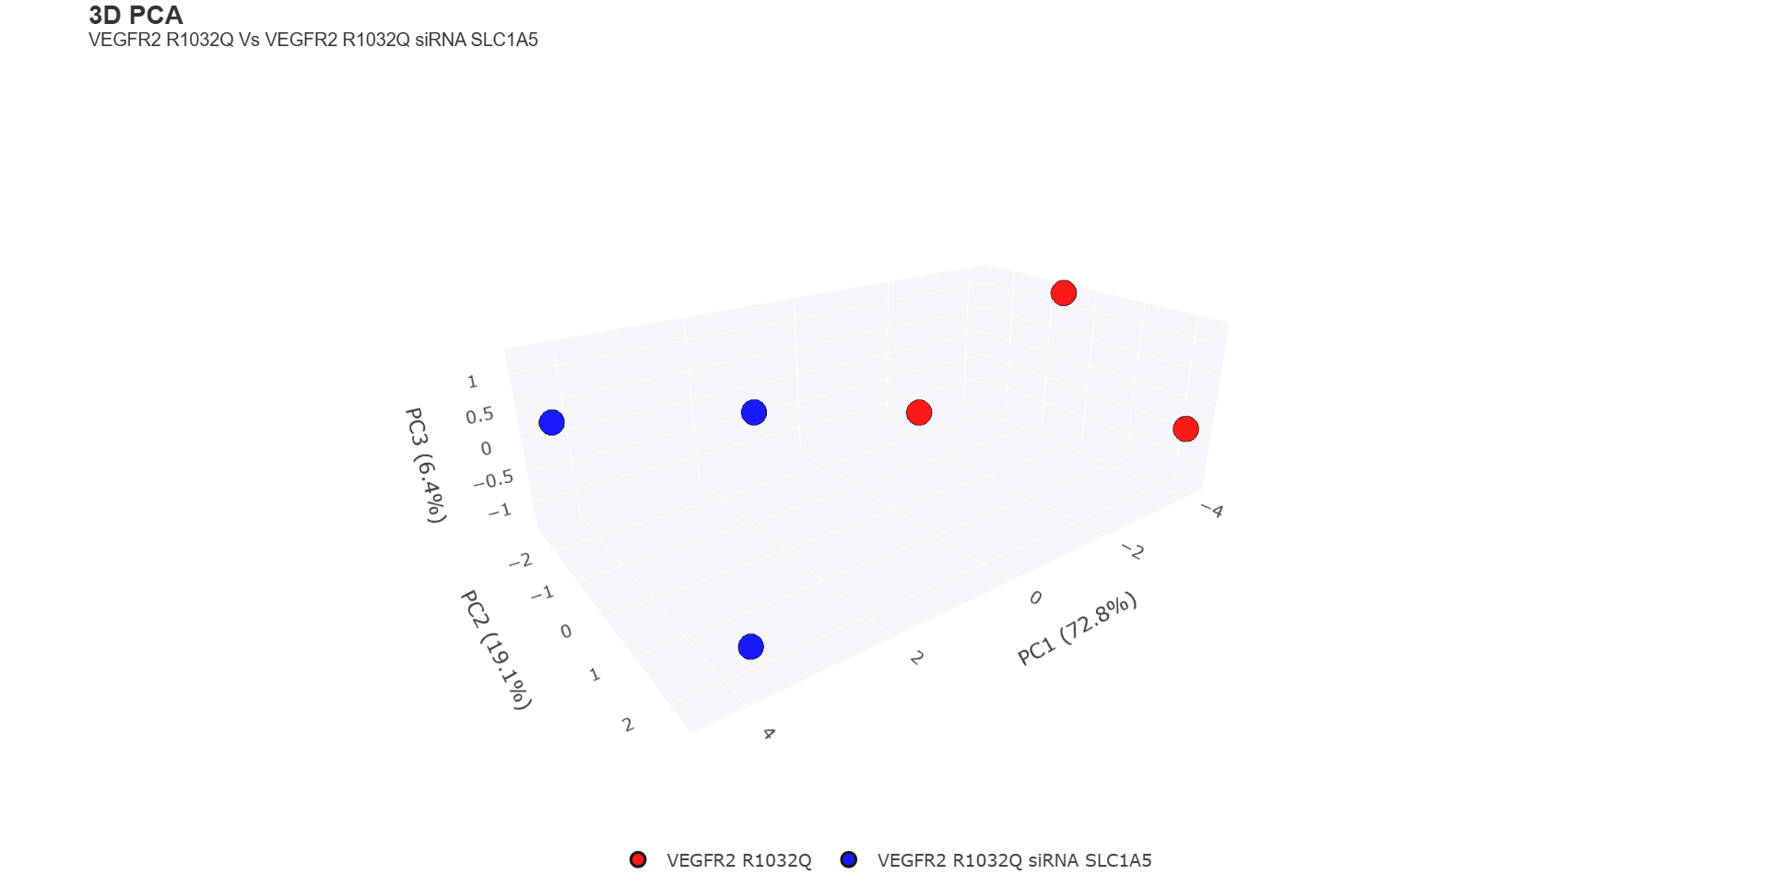
The data point are nicely clustered
It seems that an identical pattern of clusterization emerges in both cases.

Slide 11
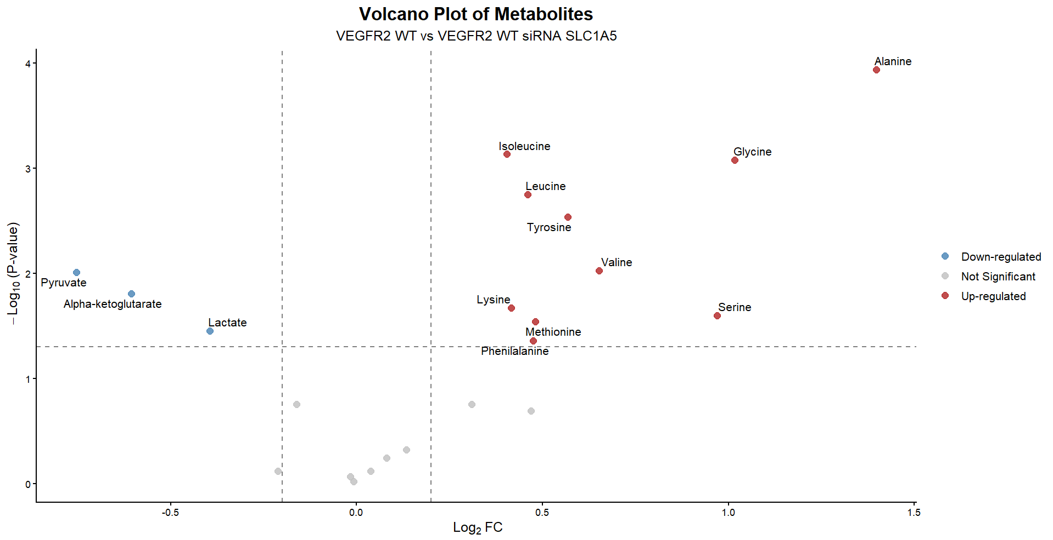
Indeed, regardless of the expressed receptor, in both cases, silecing of SLC1A5, induced a metabolic shift towards the synthesis of aminoacids, thought it seems that the cells expressing VEGFR2 R1032Q seem more susceptible.

Slide 12
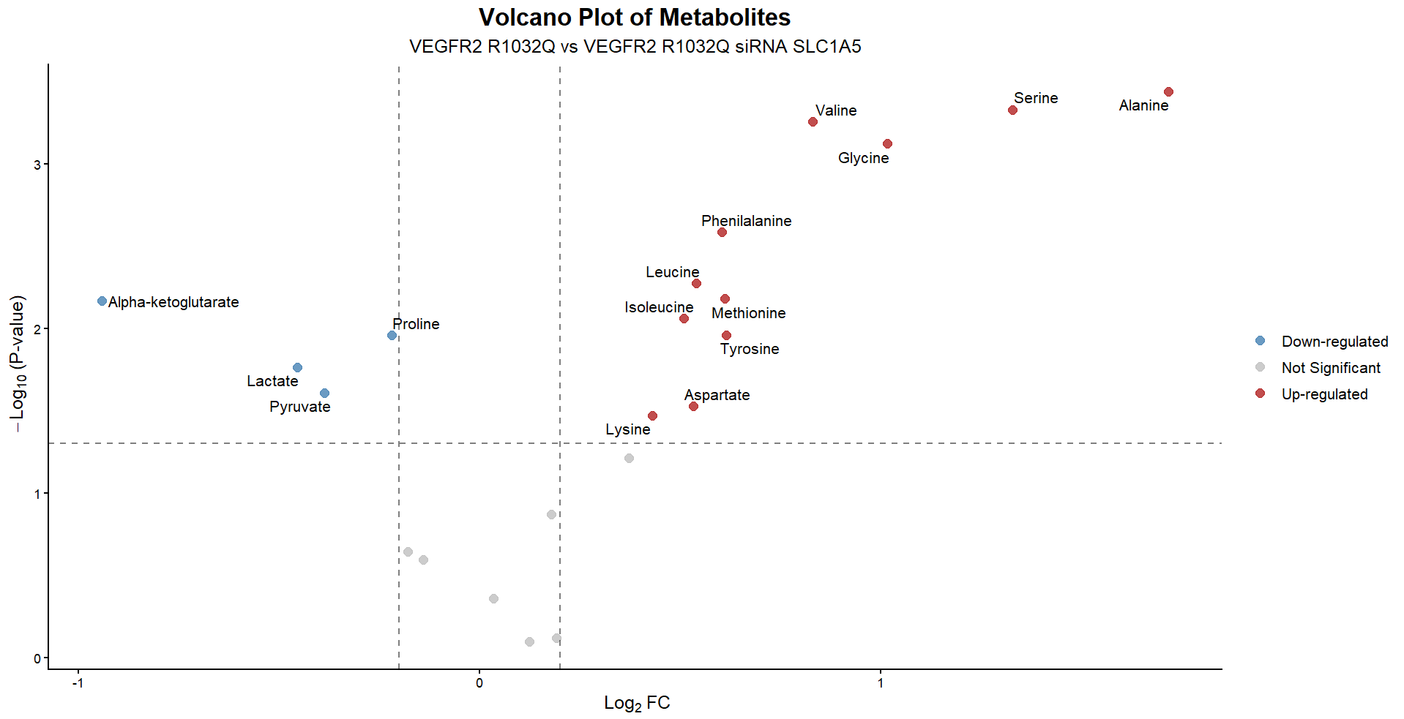
Indeed it seems that the fold changes for VEGFR2 R1032Q SH SLC1A5 are clustered into two distinct groups

Slide 13
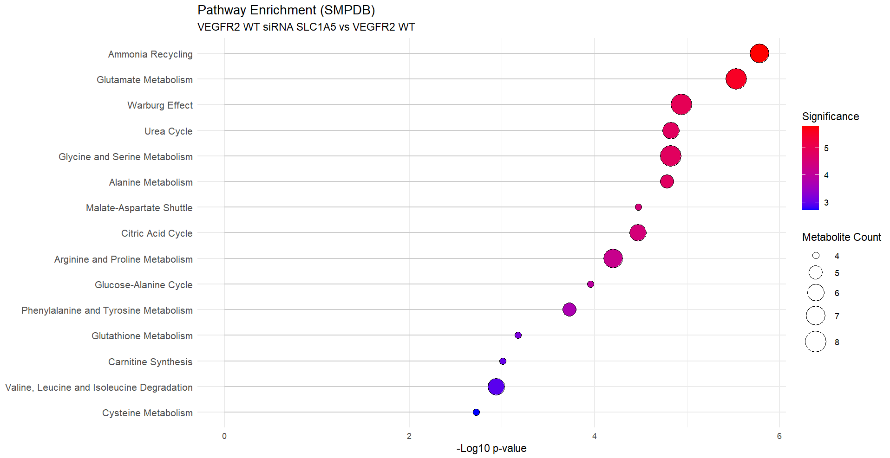
The increase in amino acid synthesis of NEAAs or uptake of essential aminoacids is confirmed by pathway enrichment analyses.

Slide 14
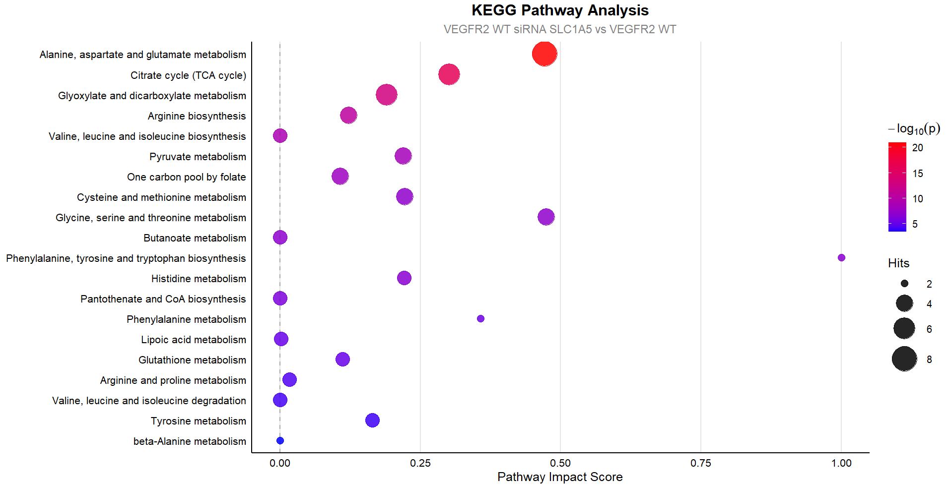

Slide 15
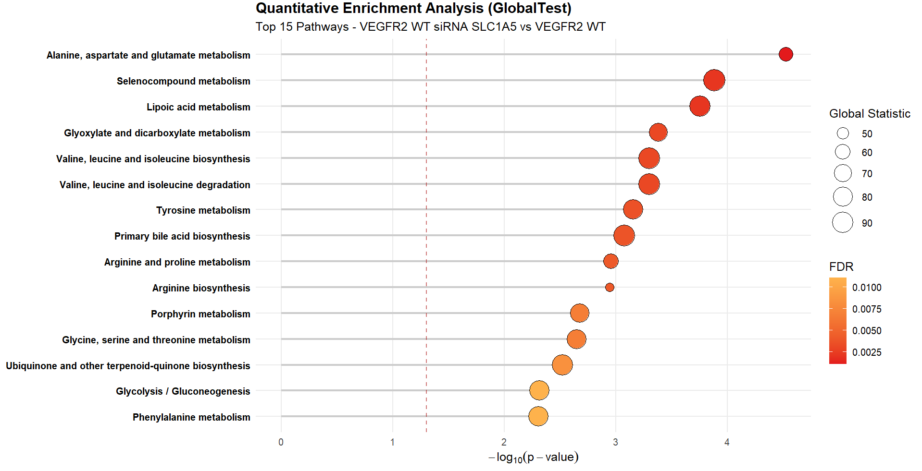

Slide 16
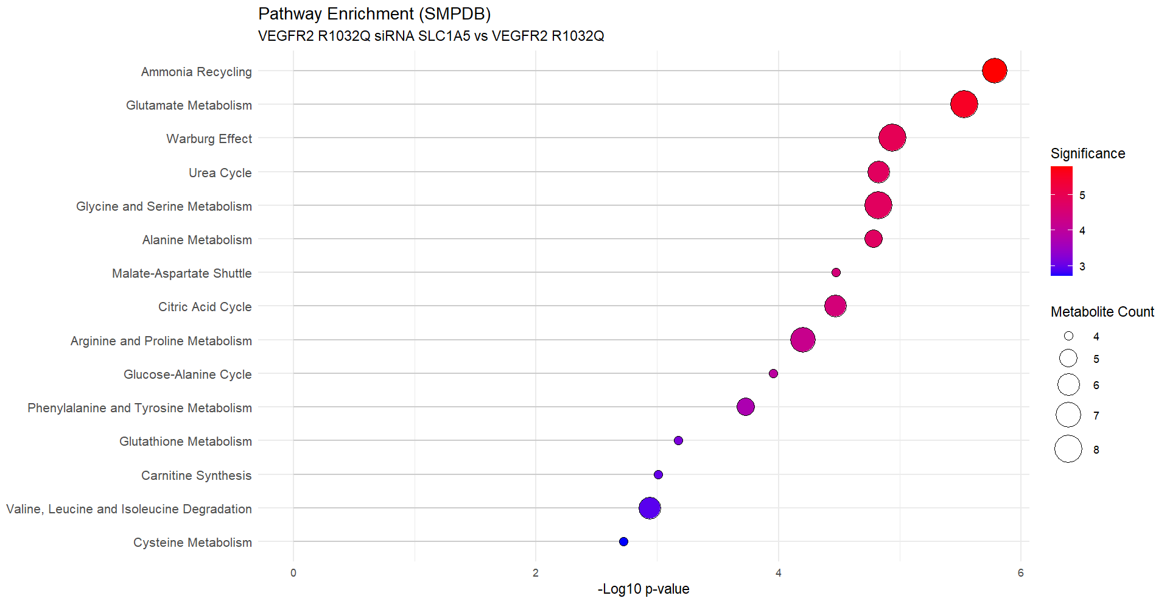

Slide 17


Slide 18
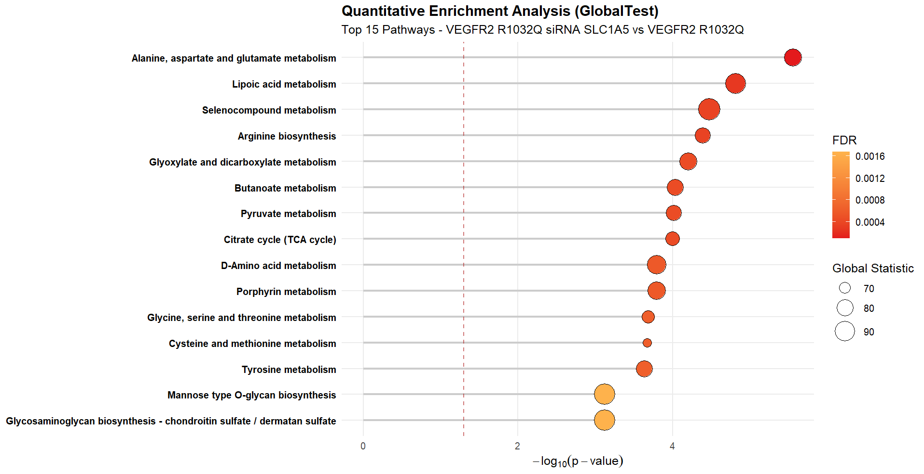

Slide 19
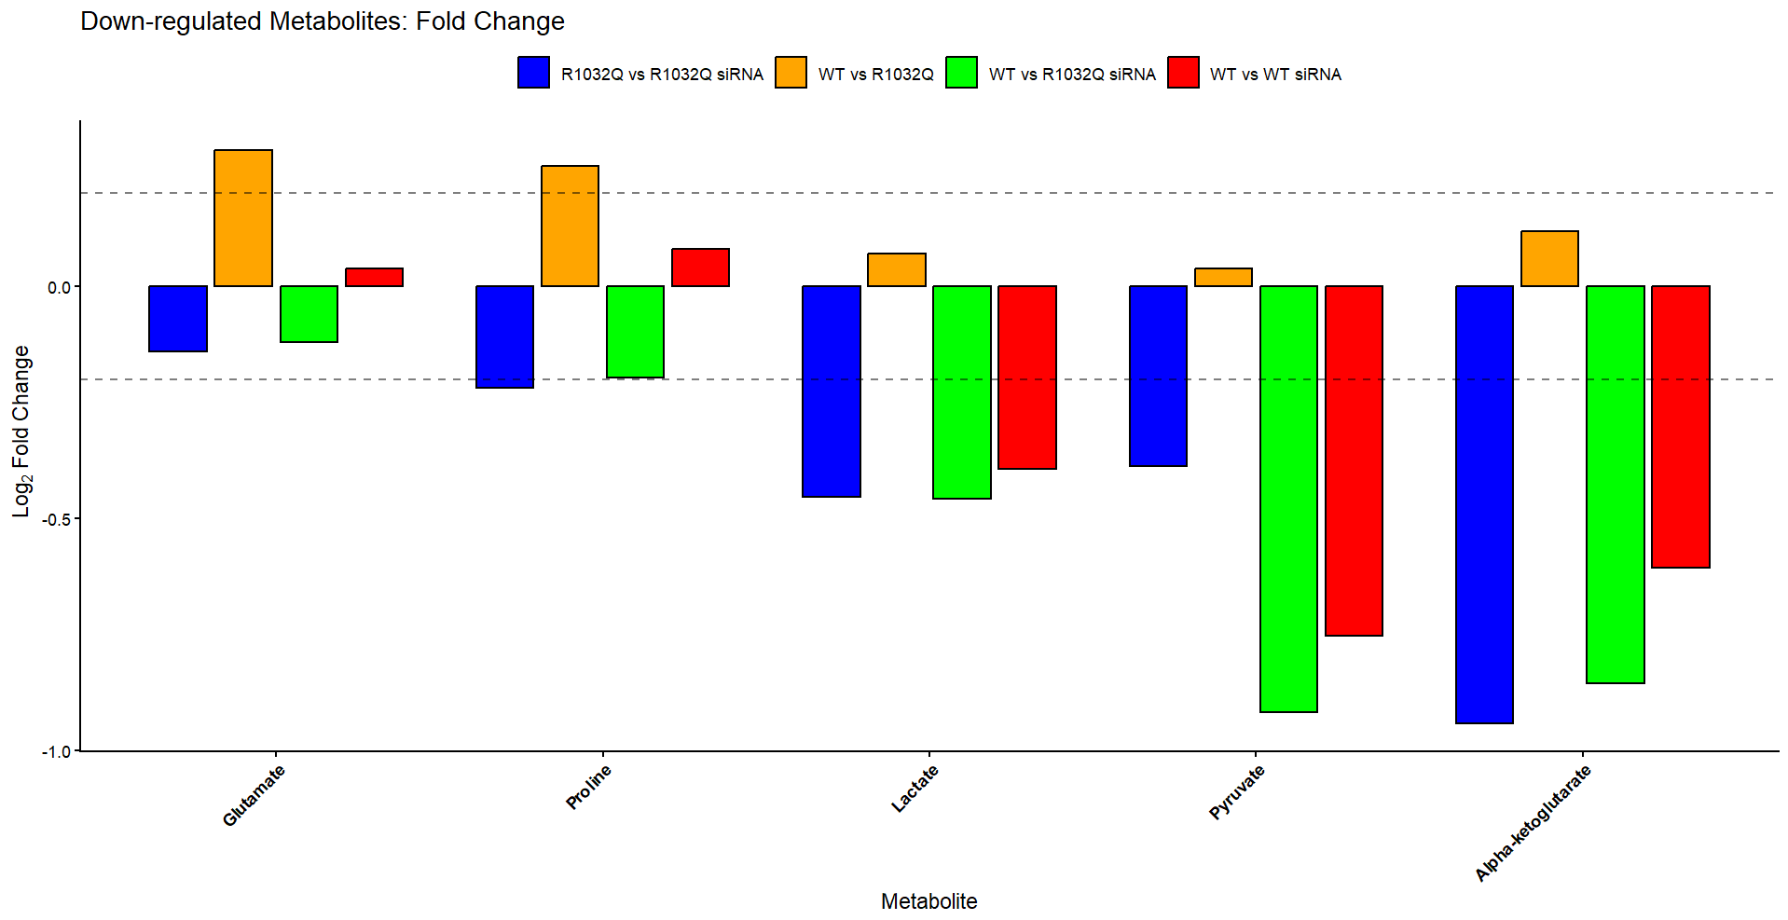
If we compare fold changes of upregulated metabolites, for R1032Q silencing condition there is a considerable increase for Serine and Alanine. Aspartate is only significantly upregulated in the R1032Q silencing condition
If we compare by significance , we obtain two clusters for the R1032Q silencing condition.

Slide 20
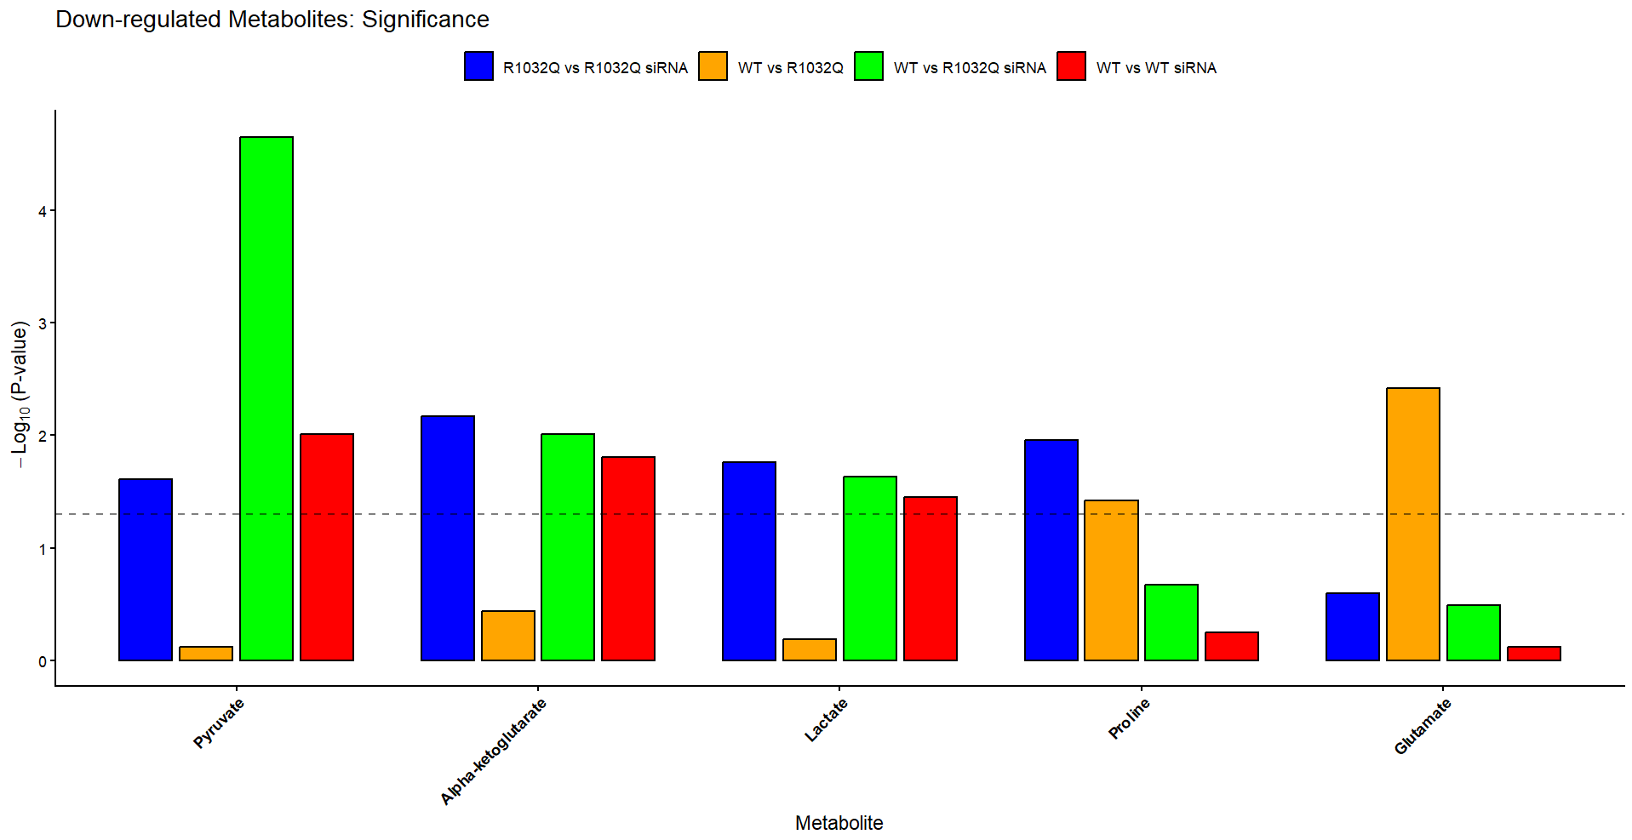

Slide 21
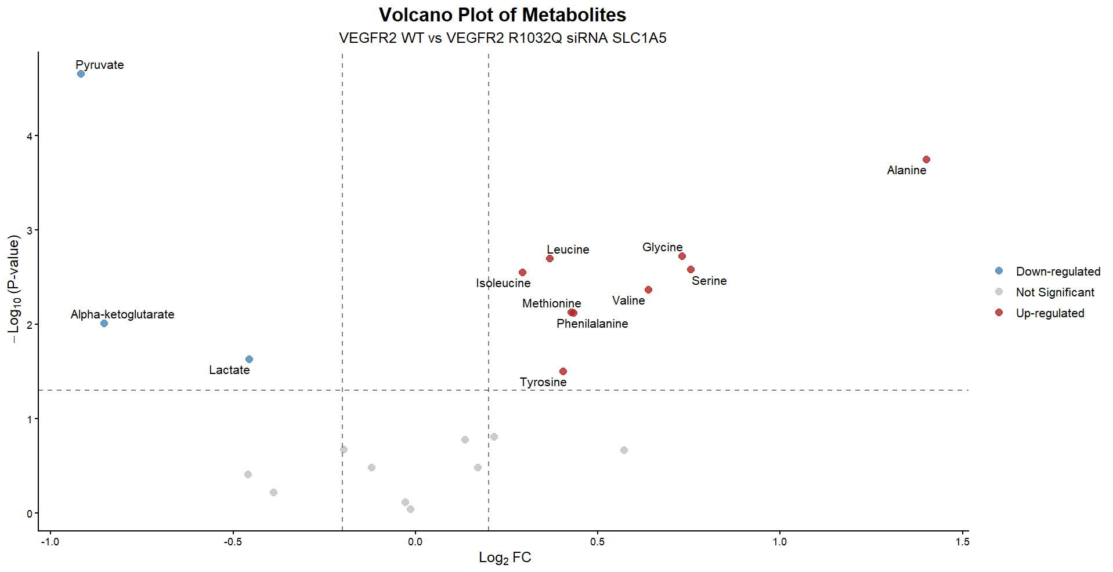

Slide 22
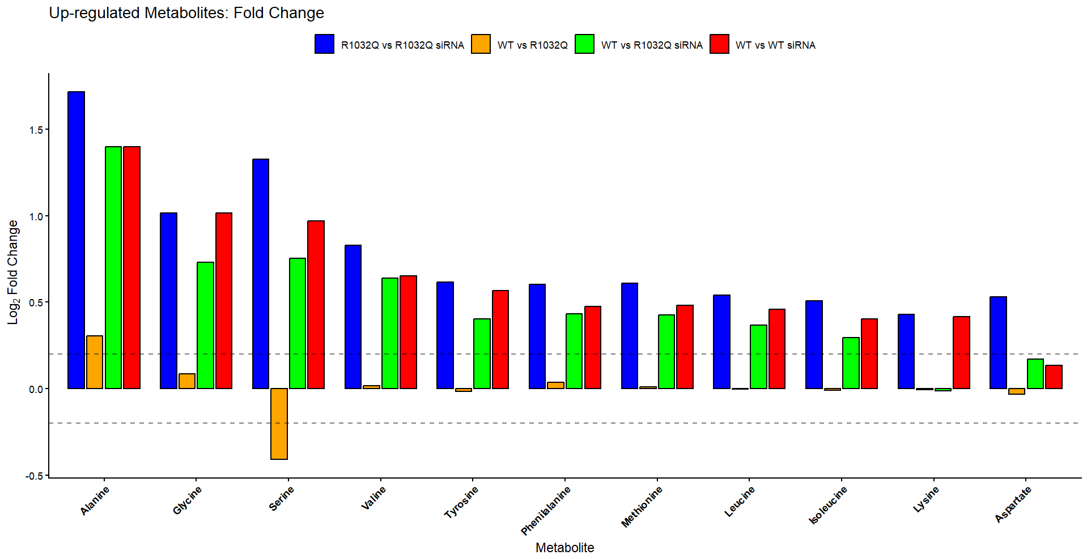

Slide 23
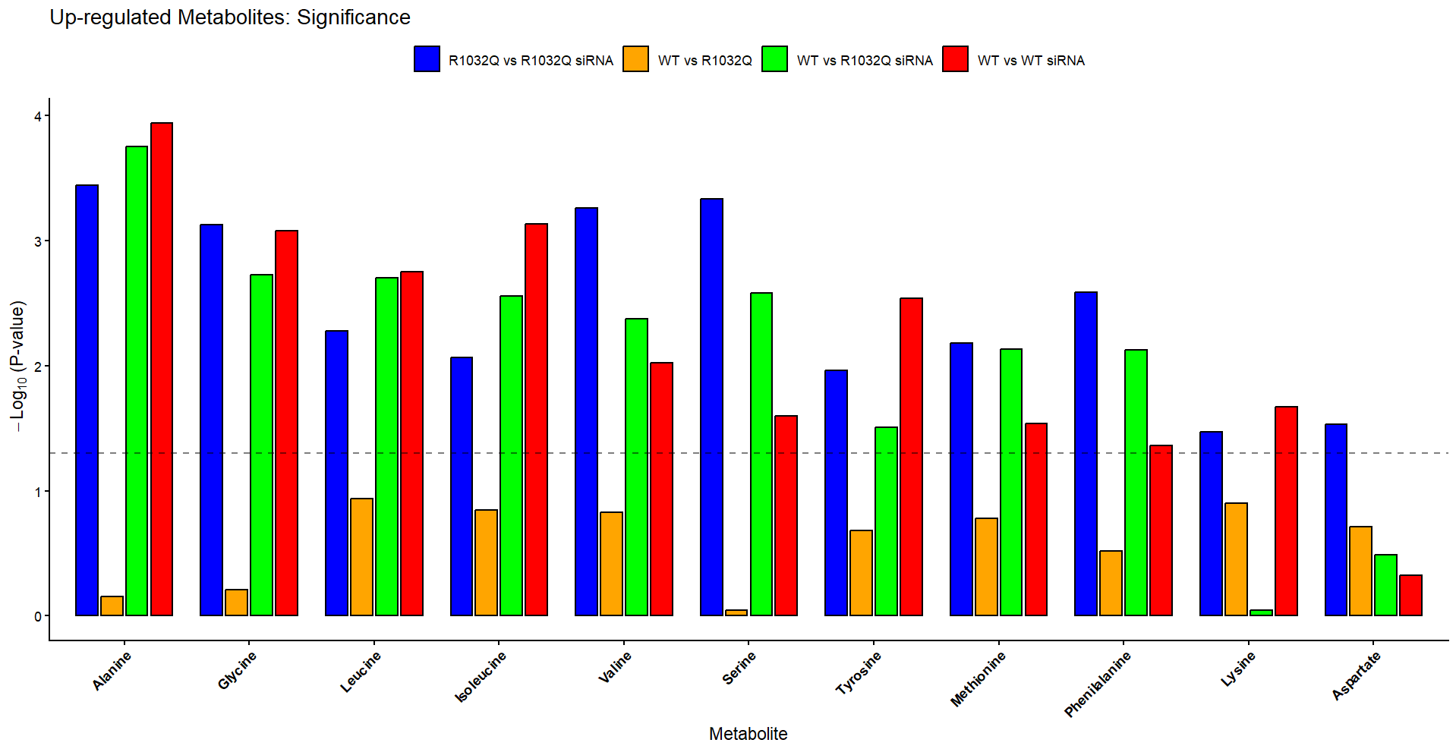

Slide 24
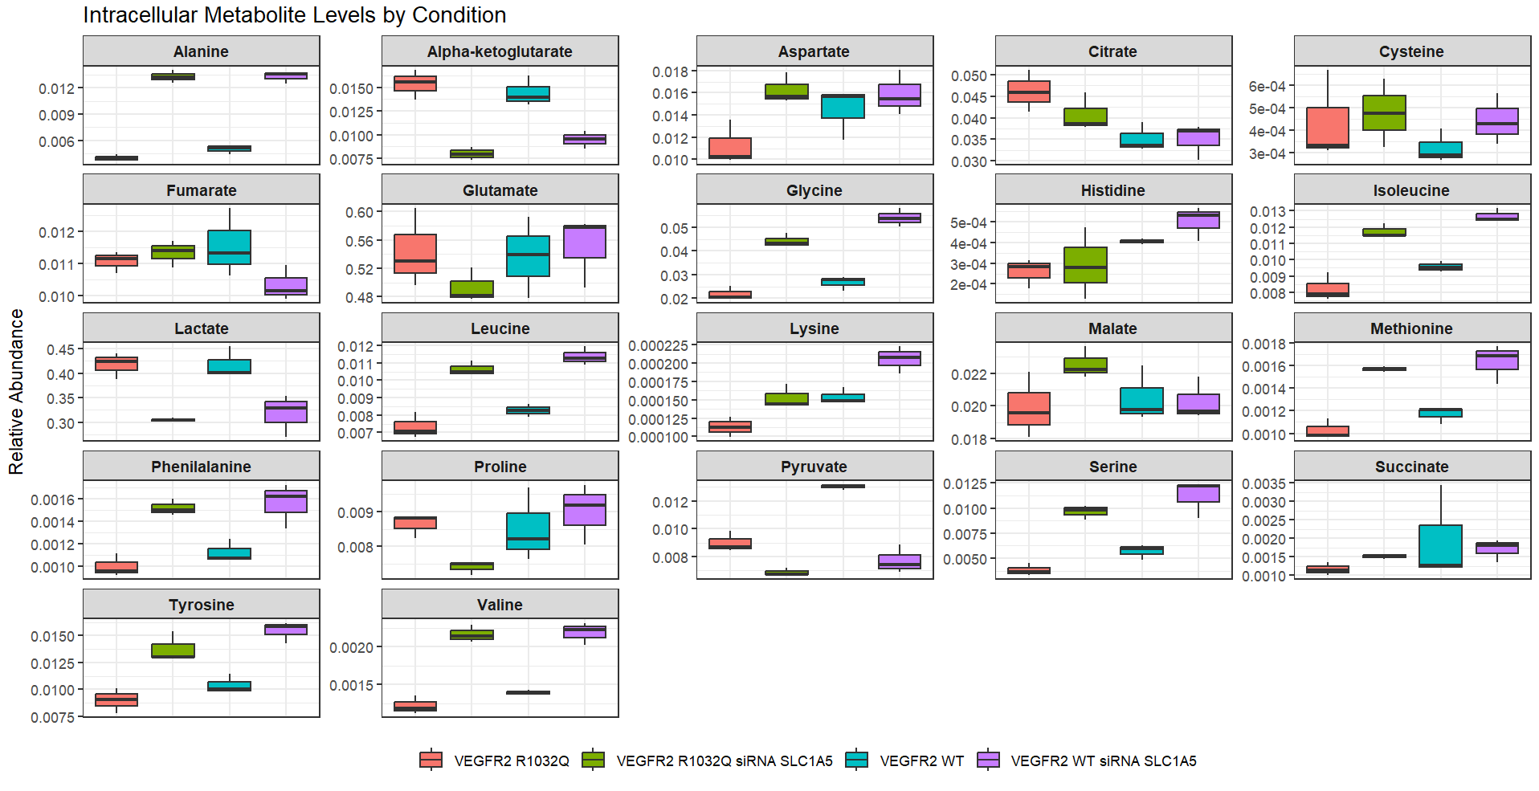
Box plot

Slide 25
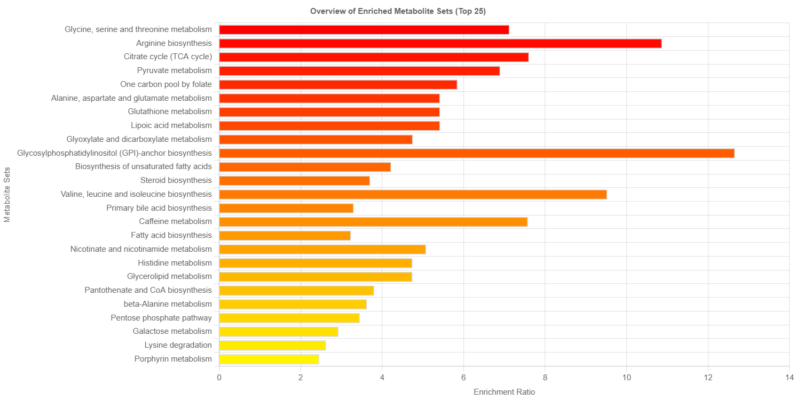
Mouse VEGFR2 WT VS R1032Q
Sebbene vi fossero una miriade di contaminanti sintetici e microbici a livello dell’analisi untargeted, sono stati individuati metaboliti coinvolti in quei stessi pathway individuati nell’analisi targeted. Di seguito risultati KEGG.

Slide 26
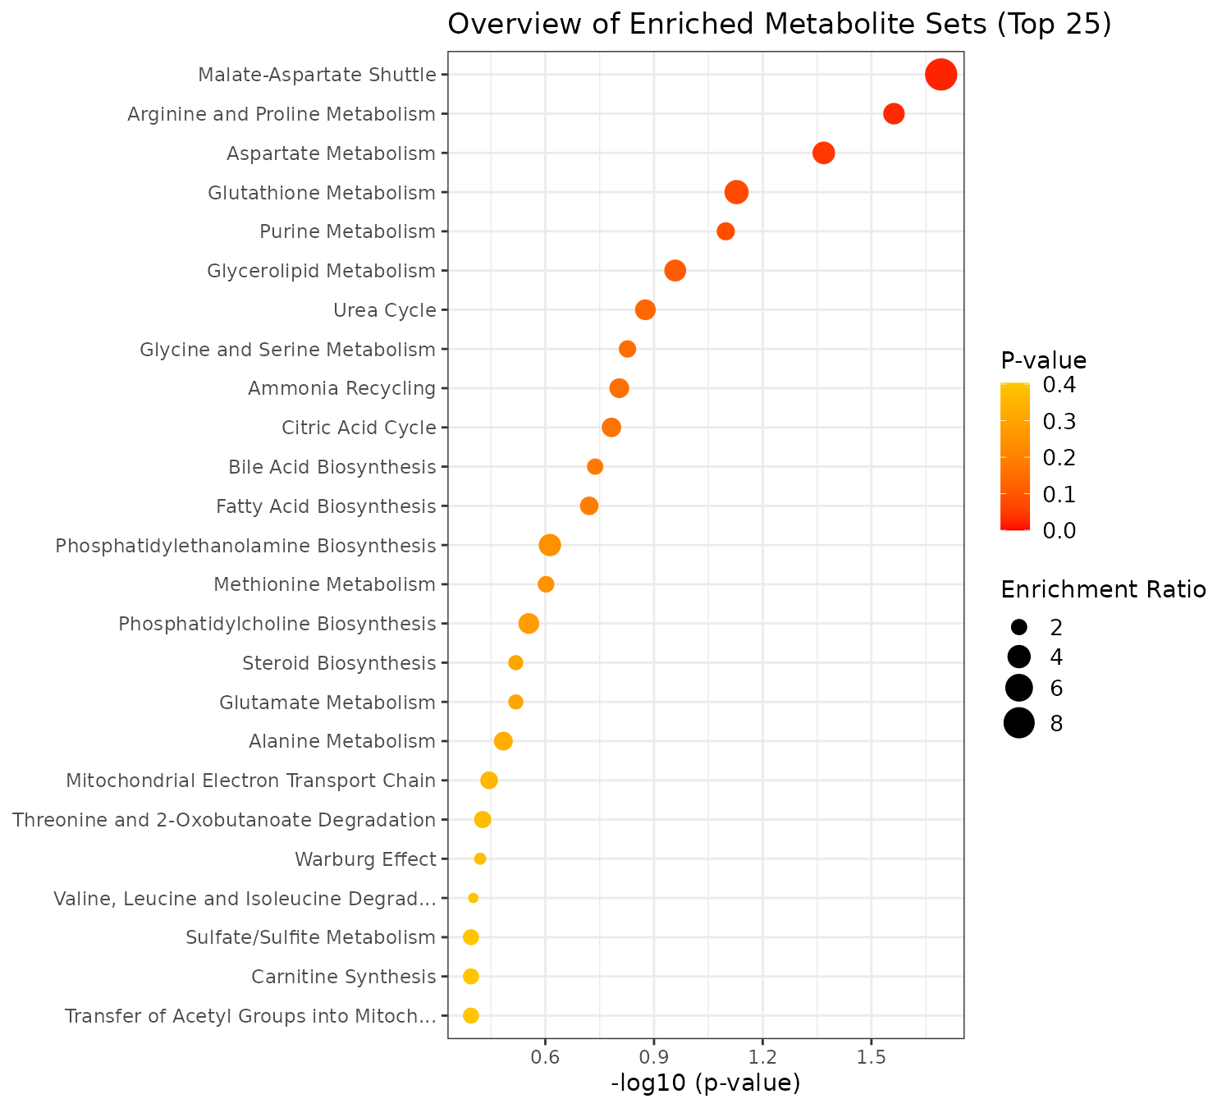

Slide 27
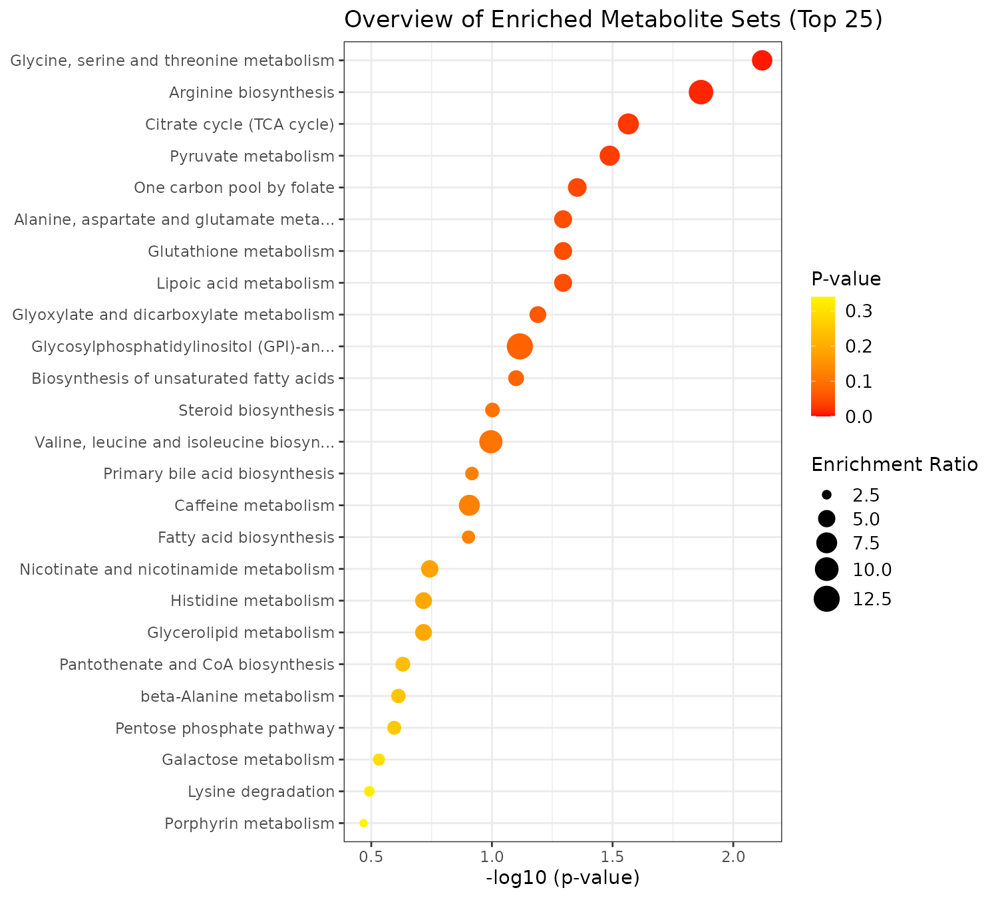
Di seguito risultati ORA smdbp

Slide 28
